Slide 1
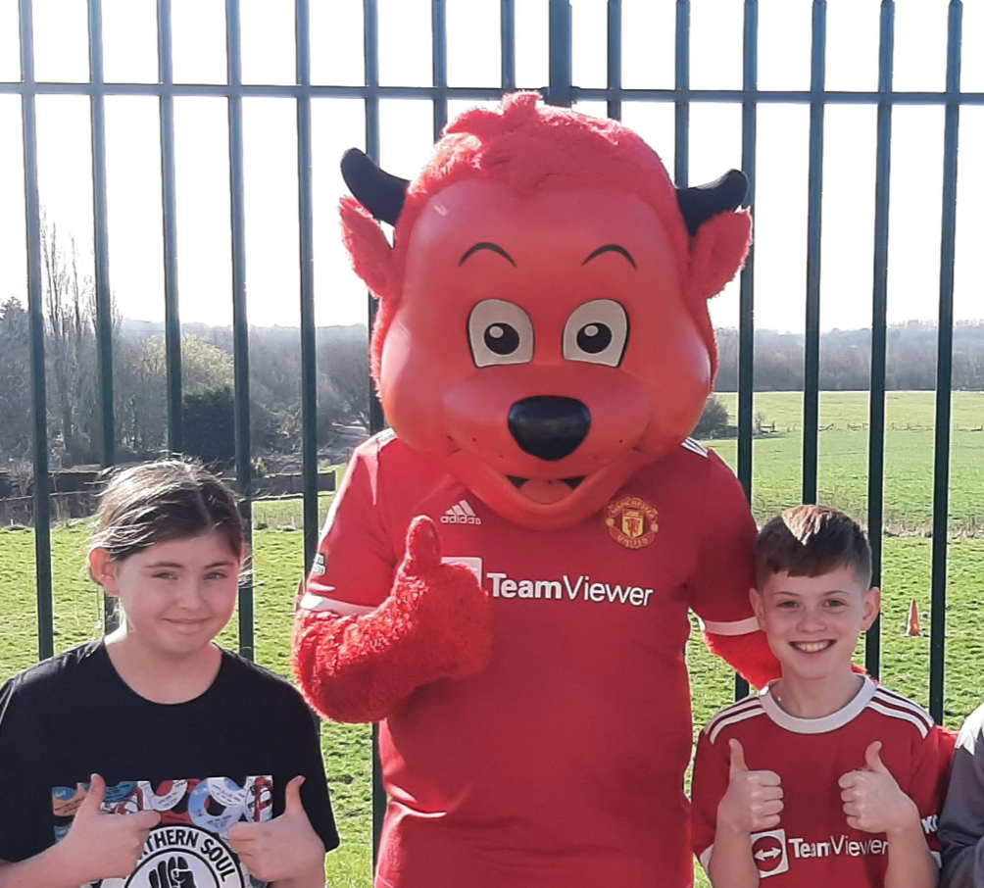
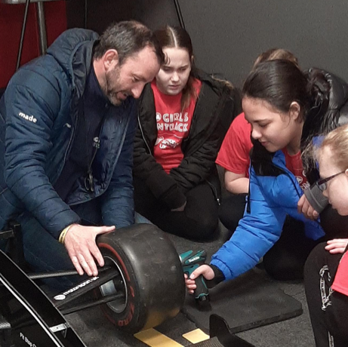
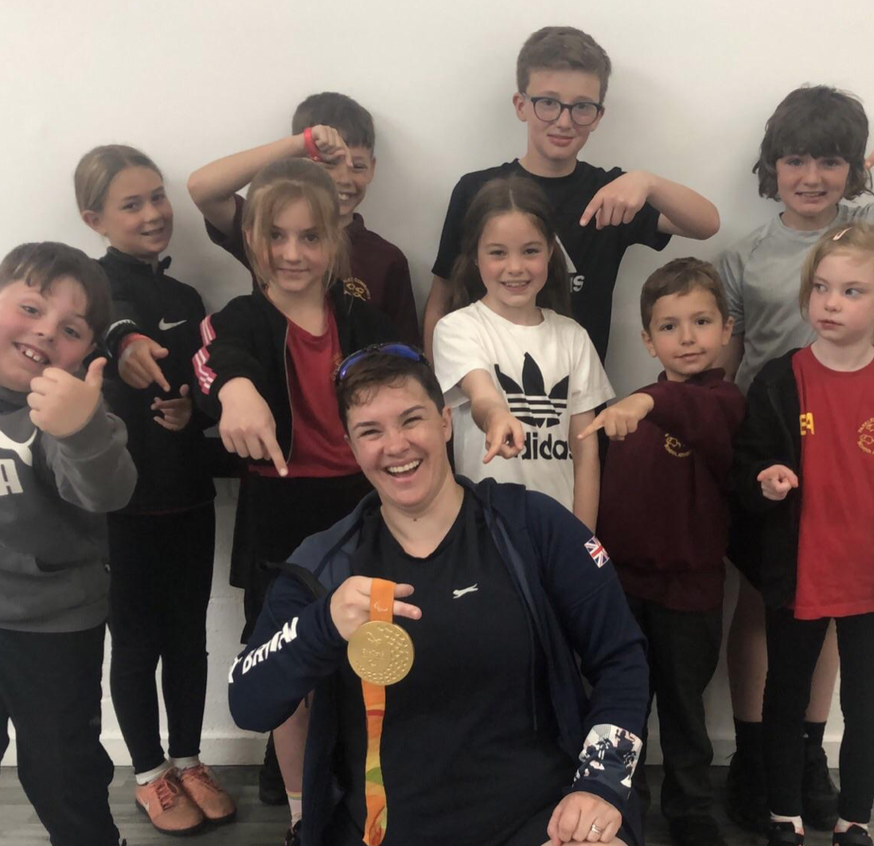
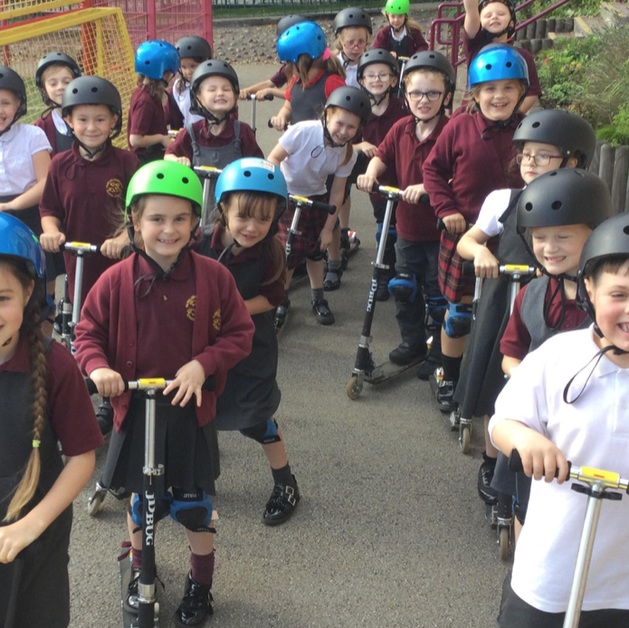
PE Budget Proposal for 2023-24

Slide 2
Key Performance Indicators (KPIs)
KPI 1: The engagement of all pupils in regular physical activity.
KPI 2: The profile of PESSPA is being raised across the school as a tool for whole-school improvement.
KPI 3: Increased confidence, knowledge and skills of all staff in teaching PE and sport.
KPI 4: Broader experience of a range of sports and activities offered to all pupils.
KPI 5: Increased participation in competitive sports.
KPI 6: Swimming Provision

Slide 3
Sports Premium Grant (SPG) 2023/2024 Proposal

Slide 4
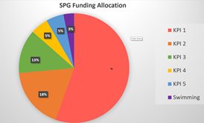
Key Performance Indicator 1: The engagement of all pupils in regular physical activity.
Intent | Implementation | Funding Allocated | Impact | Sustainability Next Steps
Engagement in physical exercise. Improve understanding of Healthy Eating and regular physical activity and to be able to articulate their feelings towards them. Spare kit readily available to all children. | 2 PE lessons a week. Young Sports Leaders implement break time sports activities. Breakfast and after school active and sports clubs. Wigan Inspiring Healthy Lifestyles 6-week block on healthy eating and fitness. | £6648 | Improved curriculum enjoyment and participation. Better articulation. Increased physical exercise every day. Improved behaviour, mental and physical wellbeing and character development. | Wigan Inspiring Healthy Lifestyles. SEND provision and Inclusion.

Slide 5
Key Performance Indicator 2: The profile of PESSPA being raised across the school as a tool for whole school improvement
Intent | Implementation | Funding Allocated | Impact | Sustainability Next Steps
Develop and add to the provision of PE into the BAU of the school. Train and mentor HLTA to provide PE provision to all of KS2. Sports for Champions School trips and enrichment opportunities. | Staff feedback action points. PE lead to train and mentor Sports Coordinator to lead a key phase in school. Book sports for champion athletes for the day in 2024 to align with the Olympics. Ensure all children have the opportunity to take part in school sports trips and enrichment opportunities. | £3357 | Continued improvement of PE provision within school. Increased enjoyment and participation in PESSPA Inspiration and links to school values. Inspiration and improving the profile of PESSPA throughout school. | Training on indoor gym equipment still needed to ensure all staff confident to use it. PE lead to continue to promote sport throughout the school and the wider community.

Slide 6
Key Performance Indicator 3: Increased confidence, knowledge and skills of all staff in teaching PE and sport
Intent | Implementation | Funding Allocated | Impact | Sustainability Next Steps
Continued utilisation of MUF. Training and mentoring of HLTA. As KPI 2. Whole staff training in meetings or on one-2-one basis. Lesson observations. Train HLTA on Forest school’s course. | Continue to use MUF as an external agency to provide training and mentoring to staff. AS KPI 2 Staff mentoring and feedback. Monitoring of provision once per academic year. Book course and attend in 2024. | £6700 | Profile of sport raised due to commitment in the timetable to PE and sport. Improved staff knowledge and skills. AS KPI 2 Better provision of PE across the school. Impacts on children in terms of confidence, social skills, language and communication, motivation and concentration, physical skills and knowledge and understanding. | Phase leaders for PE.

Slide 7
Key Performance Indicator 4: Broader experience of a range of sports and activities offered to all pupils
Intent | Implementation | Funding Allocated | Impact | Sustainability Next Steps
Wide variety of experiences outside of school and school hours important for Parklee children. Opportunity to try new skills and have new experiences to enhance character, resilience and confidence. A variety of after school clubs to give invaluable new skills and experiences | Curriculum, enrichment opportunities. Curriculum, enrichment opportunities. Multi-sports clubs after school. | £933 | Greater love of sport and experiences of different sports. Even spread across year groups of involvement in after school sports clubs as evidenced by the registers. | Sports taster days Climbing centre booked for LKS2 for Spring and Summer term.

Slide 8
Key Performance Indicator 5: Increased participation in competitive sport
Intent | Implementation | Funding Allocated | Impact | Sustainability Next Steps
Competitive sport is encouraged in both PE lessons and extracurricular activities. Commitment to Inter-schools membership will continue with planning to participate in as many local competitions as possible and as allowed by COVID-19 restrictions. | Participation in intra- and inter-school competitions. Commitment to competitive sport within the local authority by being an active member of Intra schools which gives access to their calendar of events. | £932 | Children develop important life skills such as resilience. Positive engagement in lessons and more enjoyment. | Wigan Athletic kids cup football. ATSA Interschool competitions. SEND competitions.

Slide 9
Swimming
Meeting national curriculum requirements for swimming and water safety. N.B Complete this section to your best ability. For example you might have practised safe self-rescue techniques on dry land which you can transfer to the pool when school swimming restarts. Due to exceptional circumstances priority should be given to ensuring that pupils can perform safe self rescue even if they do not fully meet the first two requirements of the NC programme of study.
What percentage of your current Year 6 cohort swim competently, confidently and proficiently over a distance of at least 25 metres? N.B. Even though your pupils may swim in another year please report on their attainment on leaving primary school at the end of the summer term 2023. Please see note above. | 87%
What percentage of your current Year 6 cohort use a range of strokes effectively [for example, front crawl, backstroke and breaststroke]? Please see note above. | 80%
What percentage of your current Year 6 cohort perform safe self-rescue in different water-based situations? | 60%
Schools can choose to use the Primary PE and sport premium to provide additional provision for swimming but this must be for activity over and above the national curriculum requirements. Have you used it in this way? | Yes following COVID lockdowns

